Slide 1

AUTOMATIC DRIVING SIMULATION GENERATION TO EXPLORE PARAMETERS OF CRASH SCENARIOS IN SELF DRIVING CARS
Sameed Tariq – 82142
Masters in Computer Science
Supervisor: Prof. Dr.-Ing. Gordon Fraser Advisor: Dr. Alessio Gambi

Slide 2
Motivation
The post-crash event analysis of car collision has not done yet by the car crash reconstruction scenarios
No realistic road geometry and environment (synthetic) for scenarios creation that does not reflect the true simulations from the car crash report.
The velocity and way points parameter of the collision is difficult to address the parameter space becomes huge when considering the velocity and way points of both ego car and victim car. This information is not included in the NMVCSS NHTSA database; thus it makes car crash report inaccurate.

Slide 3

Problem Statement
Explore the parameters such as way points and velocity for the reconstruction of car crash scenario of self-driving cars from police car crash report by extraction the aftermath information to evaluate the accuracy of the car crash simulation in realistic simulated environments.
Post-Crash Data Extraction
Open Street Map Road Geometry Data Extraction
Finding the best parameters such as Velocity and Way Points.

Slide 4




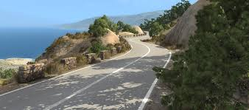
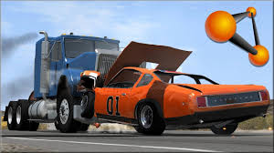
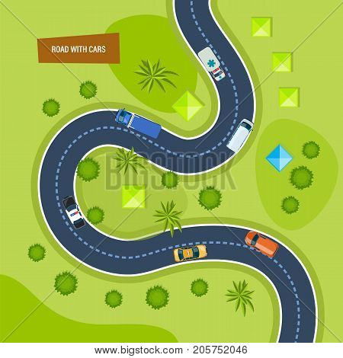

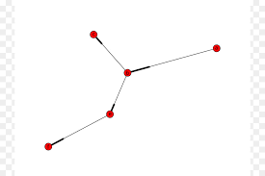
Proposed Solution

Slide 5
Natural Language Processing
Preprocessing
Dictionary Expansion
Post-Crash Event Sentences Extraction
Post-Crash Event Extraction (Striker and Victim Vehicle)
Rotation
Degrees
Direction
Distance from Crash Point
Triples Creation – Subject, Verb, Object

Slide 6
Pre-Crash and Crash Event Data (AC3R)
Striker and Victim Vehicle.
Pre-Crash Event
Initial Direction of Car.
Number of lanes
Type of Road- For Instance, T-Intersection
Crash Event
Car Damage Area.

Slide 7
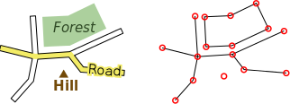
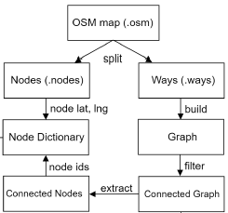
Open Street Map Geometry
Extraction of Way Points of Roads from Overpass api.
Preprocessing of open street map
Creation road Graph and removing non connected roads.

Slide 8
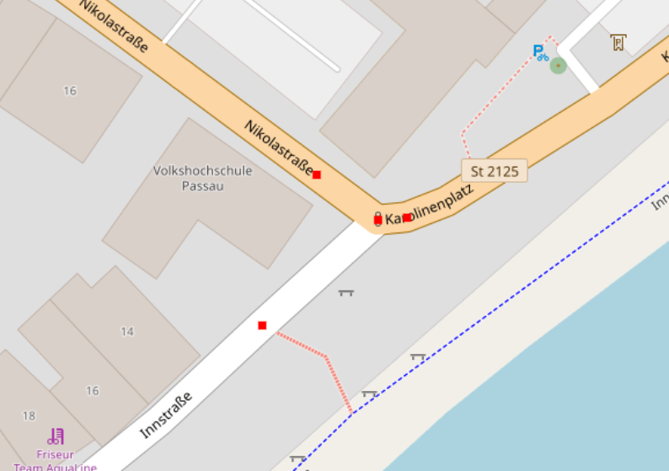
Finding Roads in Open Street Map
Querying the Graph for Type of Intersection
Number of Lanes
Width of Roads
Type of Intersection
3-way Intersection
4-way Intersection
One or multiple instance of roads Geometry

Slide 9
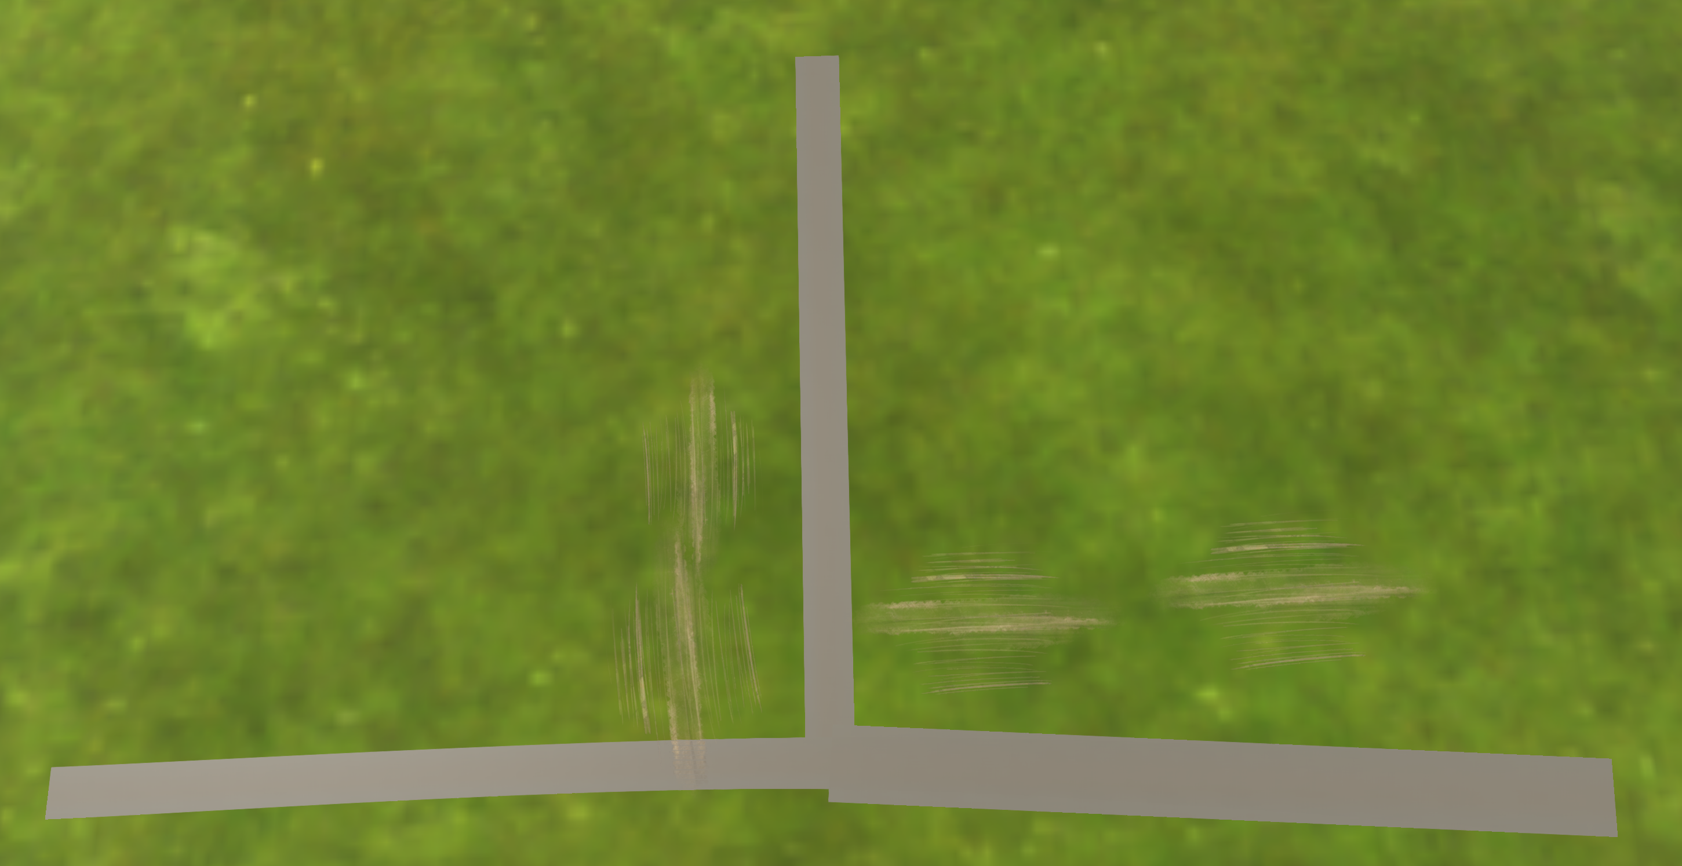
BeamNG Simulation Creation
Direction of road.
Number of lanes
Length of each road.
Angle between connected roads.
OSM -> BeamNG
(T-Intersection)

Slide 10
Vehicle State Extaction
For each striker and victim vehicle,
Car Collision Damage Area
Velocity at each Way point after crash
Distance of car from collision point
Direction of car (facing)
Rotation of Car (clockwise and counter-clockwise)
Degrees of rotation (For instance, 90 degrees)
All these information is required for the post-crash event generated simulation analysis.

Slide 11
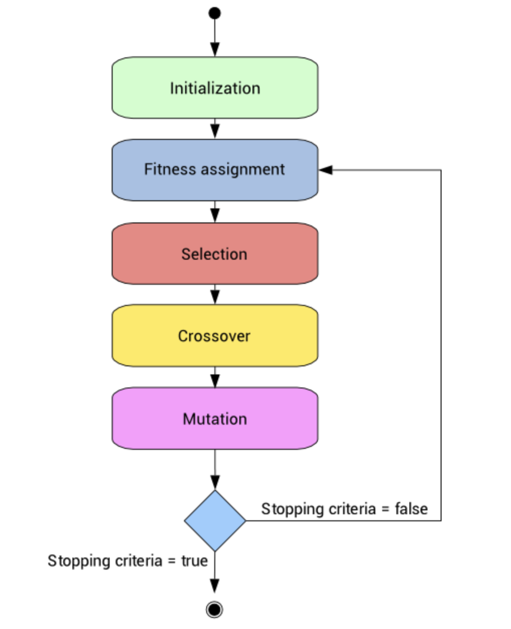
Genetic Algorithm
Input Parameters : Velocity, way-points of striker and victim vehicle.

Slide 12
Multi-Objective Fitness Function
Strong correlation between crash event (objective 1) and pos-crash event (objective 2). Our crash event is highly dependent on crash event.
If objective function accuracy is not good, it cannot pass the minimum threshold of the multi-objective function.
objective Function 1 | correct output of crash point * .25
objective Function 2 | correct output of post-crash * .625
Total Fitness | objective function 1 + objective function 2
Thresshold | 0.7

Slide 13
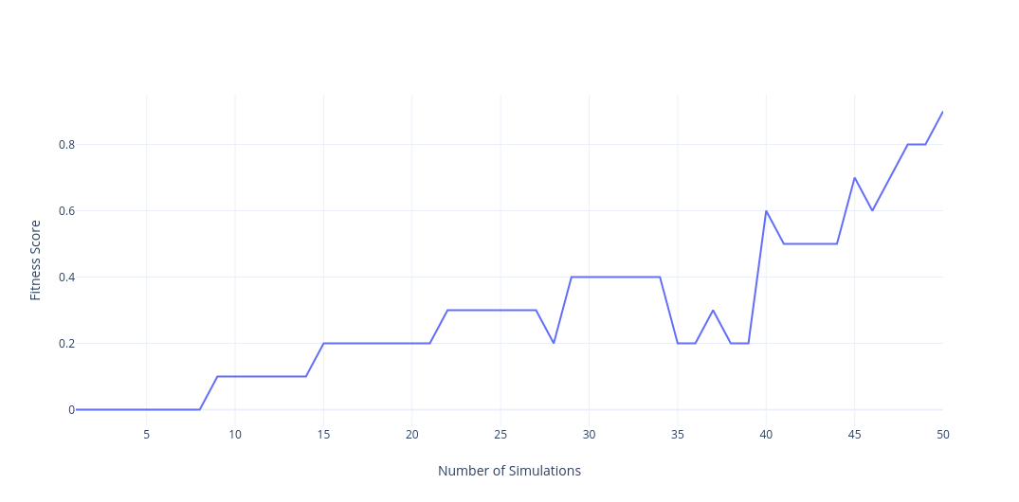
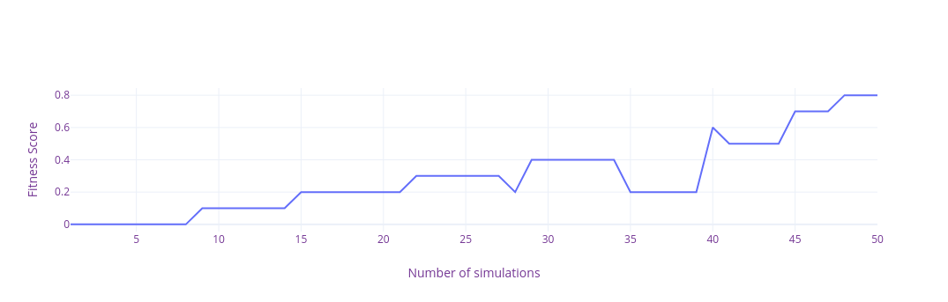
Evaluation
Road Geometry 1
Road Geometry 2
Each simulation is run for the fixed budge/time to achieve maximum fitness. Maximum fitness correspond to high accuracy.
The maximum fitness in minimum time is our final output
Striker Speed | Striker X1 | Striker X2 | Vicitm Speed | Victim X1 | Victim X2
35 | -60 | -1 | 25 | 2 | 40

Slide 14

Thank You
Any Questions

